Slide 1

GOAL SETTING Meeting - 2023

Slide 2
We nurture a culture of excellence, where everyone transparently works together to passionately deliver in everything that they do.
An environment where our employees are recognized for their contributions, inspired to take ownership of their own development and trust that their voice counts.
A culture where leaders proactively coach their teams to succeed, and everyone understands their role in helping the organization to grow into the future

Slide 3
Guideline for HRBP
This toolkit is to ensure that our Leaders/Division heads/People managers have effective goal setting with their teams & successfully cascade goals through a top-down approach. Throughout this toolkit, you may customize slides & include accurate information about your Divisional/Functional strategic priorities as you see fit.
Meeting Structure:
Preferable face to face. When booking the venue, think about having enough space for teams to break out for discussions and work.
In case of remote locations make sure to send activities by e-mail prior to your meeting.
Ensure that there is one moderator for each 5 - 6 attendees to help you with group activities. Moderators can be from the business or HR, Moderators needs to be well trained on how to facilitate the discussion and how to construct SMART objectives.
Meeting Set up:
The recommendation is to have the manager with their N-1 team members. The meeting is to be led by the manager and facilitated by the HRBP. Keep in mind that ideally you have a facilitator on each table group to facilitate the discussion
Time Required
3 - 4 Hours

Slide 4
Objective of Goal Setting Meeting
Instruction: HRBP to Use this slide to explain the critical considerations to effective goal setting when aligning with the Leader (Meeting owner).
Goal Alignment:
Vice Chairman
Create transparency and alignment behind Divisional/Functional strategic priorities.
Enable employees to see a direct link between individual goals and Division/ Functional strategic objectives.
Reinforce what high performance looks like for the team.
Clarify what great will look like and what metrics will be followed.
Help employees focus on team goals, coordinate work with peers & understand interdependencies to achieve goals.
Help employees create SMART Goals and put goals on iGrow.
Division/Function Leadership
Department heads
People Managers
Individual Contributors

Slide 5
Roles & Responsibilities
Preparation
Goal Setting Meeting
Action
HRBP
Meeting Owner (Business Unit Leader/function Head/ Senior Leader)
Send out e-mail to meeting owner(template provided)
Prepare meeting agenda and share with meeting owner. (Template provide)
Ensure meeting owner is prepared with the Divisional/Functional strategic priorities .
Book adequate meeting room for the meeting.
Ensure you have enough moderators to support you with group activities
Send out meeting invite to all attendees
Send out e-mail to all attendees sharing meeting objectives & expectations.
Review template & be ready with Divisional/Functional strategic priorities.
Define key goals tied to BSC priorities, and what is being expected from the team to deliver.
Review Manager guide & meeting activities.
Have a conversation with matrix managers prior to the meeting to ensure alignment & avoid any conflict
Facilitate the session
Moderate the group activities
Provide feedback on employee goals supporting the team to create SMART goals.
Open and lead the workshop
Ensure employees understand Divisional/Functional strategic ambition
Allow time for Q&A to ensure understanding
Leverage activities to ensure employees are clear of what is expected from them.
Ensure employees logged SMART goals on IGrow.
Select random sample and check quality of goals
Drive 1:1 conversation with direct reports to secure final goal alignment
Cross check that what gets captured in iGrow, is aligned with agreements made.
Ensure all team log their goals on IGrow

Slide 6
HRBP E-mail to Meeting Owner
Instructions: HRBP to send e-mail to meeting owner with the suggested Agenda and Manager guideline word document
To: Insert e-mail for meeting owner
From: HRBP name
Subject: 2023 Goal Setting Meeting
Dear meeting owner name,
As we enter a new year, ensuring there is directional clarity and goal alignment right from the beginning is critical to ensuring you and your team know where you are going and how you intend to get there over the next 12 months.
Accordingly, our proposal this year is to conduct a 3-4 hours goal setting workshop with your team (meeting owner & HRBP to decide on attendees) to ensure we communicate the overarching strategic focus, discuss the key priorities, clarify what is expected from them personally, define what success would look like and what KPIs will be utilized to measure success.
To drive goals setting means giving people a clear understanding of what they have to deliver and helping them to deliver it. To enable this, we recommend sharing
The Divisional/Functional strategic agenda
What does this mean for your team.
Key big ticket items the team would need to deliver on
To enable a successful meeting we recommend that you,
Review the word document manager guide
Send out the e-mail template attached to the attendees
I will book a slot in your calendar to align on further steps & agree on the meeting agenda, activities & content.
Looking forward to partner with you in order to have a successful goal setting meeting.
Regards,
[HRBP Name]

Slide 7
Meeting Owner E-mail to Attendees
Instructions: Meeting owner sends this e-mail prior to Goal Setting meeting Use this e-mail in preparing o communicate goals to your team via email. Customize the text in red for your division. Its optional either to share the Divisional/Functional strategic drivers prior to the meeting or during the meeting.
To: Insert e-mail list for your function /division
From: Meeting owner name
Subject: 2023 Goal Setting Meeting
All,
As we get ready to drive our strategic ambition, I would like us to take the time to ensure you are all aware of the direction we will be taking together for 2023. I am happy to share our Divisional/Functional strategic drivers, and what this means for us this year (see attachment).
What is New?
The work we do today involves a high level of interdependency, and for this reason, I would like us to create our individual goals together. This will ensure that we all have visibility on what we are driving, we ensure alignment and consistency across the team, and we provide opportunities to create synergies across.
Action Needed from you:
Take the time to go through the material attached and reflect on what key elements would fall under your accountability. Review your 2022 goals and determine if any may need to be carried over..
What to Expect?
Over the next days, you will receive:
An invite from your HRBP for a collaborative goal setting meeting.
Please contact me or your HRBP in case you have any queries. As we look to further our organization’s growth, I am excited to start this process.
Sincerely,
[Meeting Owner Name]

Slide 8
Meeting Template

Slide 9
Meeting Agenda - Sample
Instructions: Use this sample agenda to structure meeting while communicating goals to your teams.
 | Agenda Item | Description | Time | Speaker
1. | Introduction | Welcome and share the key objectives and desired outcome of the meeting | <Input the time required for each agenda item> | <Input the speaker name for each agenda item>
2. | Overview of Divisional/Functional strategic priorities | Provide a brief summary of the Divisional/Functional strategic priorities for the year and the business unit/teams’ key priorities
3. | Q&A Divisional/Functional strategic priorities | Invite questions on the information shared.
4. | Team Priorities & Opportunities | Team discusses together how will those deliverables get broken down into accountabilities…will there be any collaborative team deliverables…and who will be responsible for what.
5. | Guidance on Employee Goal-Setting | Guide the employees on how to set individual SMART goals for the year ensuring that the goals clearly contribute to team and Divisional/Functional strategic priorities.
6. | Goal Setting | Start Goal setting activity where team members starts drafting their goals & discussing have their peers
7. | System | Share with attendees how to navigate the system & give sometime to attendees to log their goals on the system & share if the have any challenge
8. | Wrap up | Summarize the meeting points & discuss next steps

Slide 10
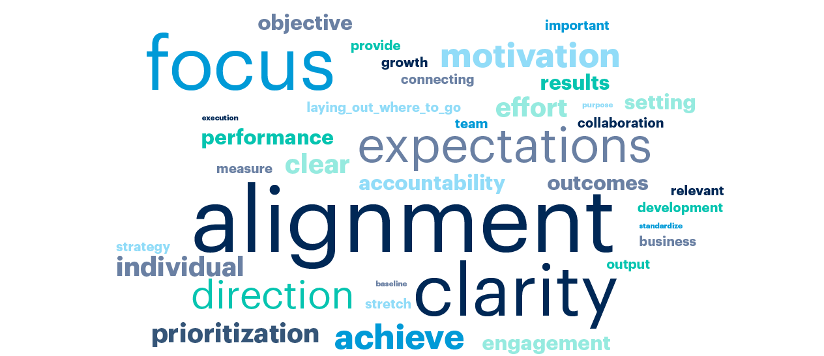
Purpose of Goal Setting
Instructions: Activity 1: Meeting owner will start asking the attendees why is goal setting important before displaying this slide and listen to their answers, then display the slide & summarize what they shared.

Slide 11
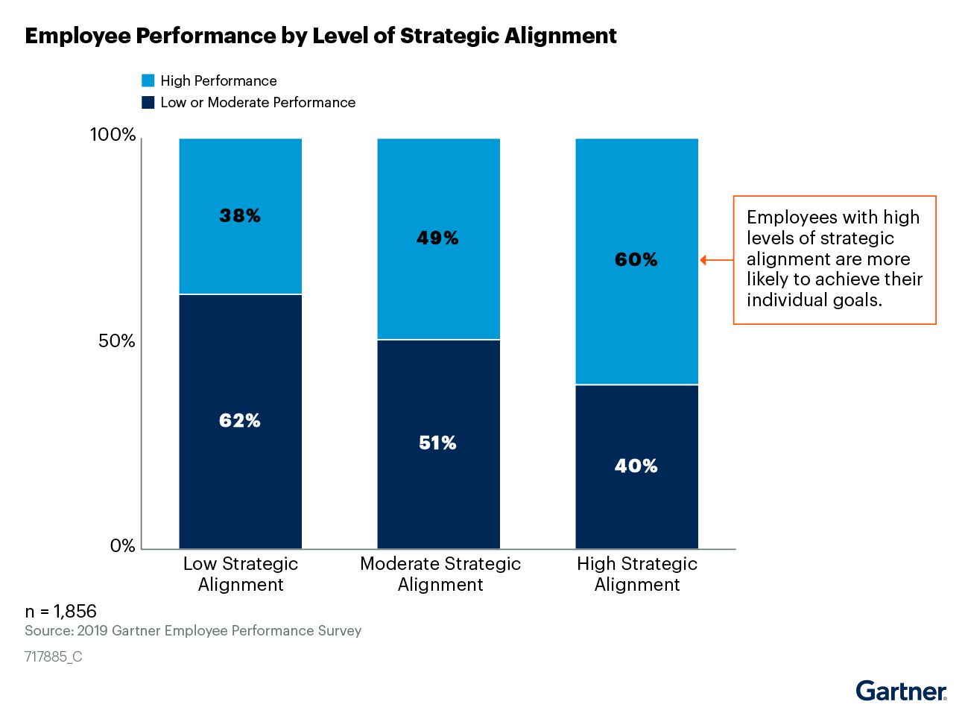
Purpose of Goal Setting
Instructions:: Meeting owner will share the most important 3 points in conducting goal setting.
Provides a clear line of sight, connecting individual contribution to overall business results. Clarifies the expectations
As an individual
Or as part of a team
Ensures that individual goals are aligned, and that cumulatively they deliver on the expectations of the team, unit and division.

Slide 12
Divisional/Functional Strategic Priorities
Instructions: Meeting Owner to share divisional/functional strategic priorities providing a direct link between individual and divisional/functional strategic priorities. Allow time for questions from employee to clarify what is expected from them personally
Divisional/Functional Strategic Priorities

Slide 13
2023 Priorities & Opportunities
instructions: Activity 2: (30 min) In case the meeting owner didn’t share the Divisional/Functional strategic priorities prior to the meeting with their teams, this activity should take place in order to allow attendees to take some time and reflect on the Divisional/Functional strategic priorities, and what does this mean to them individually.
Meeting owner will ask attendees to take some time and reflect individually on what was shared and start capturing their individual priorities using the template below.
HRBP would then open a team discussion and ask the attendees what are the priorities that need to be owned by the full team? What are the opportunities to collaborate with different peers.
Priorities & Opportunities Sheet
Individual Priorities
Priority 1 | 1. ………………………………….... 2. …………………………………....
Priority 2 | 1. ………………………………….... 2. …………………………………....
Priority 3 | 1. ………………………………….... 2. …………………………………....
Priorities that need to be owned by the full team | Opportunities to collaborate with different peers.
1. ………………………………….... 2. ………………………………….... | 1. ………………………………….... 2. …………………………………....

Slide 14
Setting SMART GOALS
Instructions: HRBP to facilitate this part
Ensuring clarity around the objective set.
Ask yourself, “if someone outside of my team read this objective, would they understand what I aim to achieve”.
S
SPECIFIC
M
MEASURABLE
Defining the metric to assess success.
The more this is spelt out, the more objective one can be during the year end evaluation. The measure can be both quantitative or qualitative. Ideally it also defines the permissible margin of deviation.
A
Ensure the goals are challenging and provide a stretch beyond the regular everyday work.
Ensure that the right tools, capabilities and knowledge are in place to deliver on the objective.
ACHIEVABLE
R
RELEVANT
Does it tie into the strategic priorities of your business
T
Specify a date or amount of time when the goal must be completed
TIME-BOUND

Slide 15
Setting SMART and Aligned Goals
Setting SMART GOALS
Instructions: HRBP to ask attendees to use the below questions while developing their goals in activity 3
SPECIFIC
Does the goal clearly define expectations in terms of actions and outcomes? What exactly will be done/delivered/actioned?
What is the outcome expected?
What would great look like, and how will it be measured?
Does the goal define specific metrics (quantity, quality, cost, etc.) that can be objectively measured? & what data source will be utilised to gain the information?
MEASURABLE
ACHIEVABLE
Is the goal challenging but reasonable?
Does the employee have the skills and experiences necessary to achieve the goal?
Is achievement of the goal within the employee’s control?
Can the employee reasonably be expected to successfully complete the number of goals assigned?
What might need to beput in place to enhance likelihood of success?
Is the scope of the goals appropriate given the employee’s job responsibilities and level?
Does the goal clearly connect to divisional and/or function goals?
Does the employee understand how his/her goal contributes to the company’s goals?
RELEVANT
TIME-BOUND
Does this goal need to be delivered at a specific timing, or will it run throughout the year?

Slide 16
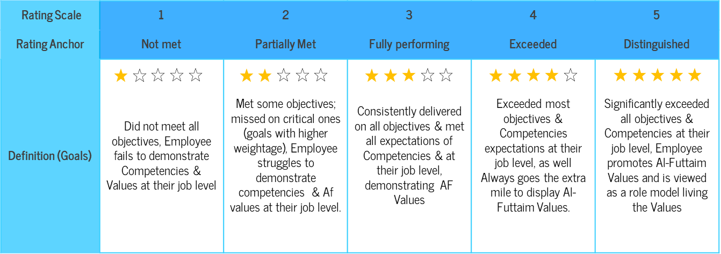
Identify Success Measures for Your Goals
Instructions: HRBP to explain to attendees what are the success measures they need to consider while setting goals. Ask the attendees to Reflect on the questions below to identify how measures of success can be added to your goals at fully performing, exceeded and distinguished levels.
What does high performance look like in delivering your individual goals?
How will the goals be measured? What will ‘Fully performing’ look like?
What will ‘exceeded’ and ‘distinguished’ look like?
Achieving a ‘meets’ level, in aggregate, should be equivalent to the business unit or function successfully delivering its stretch business goals.

Slide 17
Lets’s Practice
Instructions: HRBP to share with attendees, how does a SMART goal look like. Preferably add goals from your own division.
SMART Goal | SMART Success Measures
Drive improvement in the engagement and wellbeing scores with a focus on the below 3 questions: Work life balance Action planning follow up My immediate supervisor takes an active interest in my Growth & Development | 1. Work life balance (86%) –Target 90% 2. Action planning follow up (86%) – Target 90% 3. My immediate supervisor takes an active interest in my Growth & Development – Target 90%
Increase B2B sales of car units for Toyota Brand | Increase sales of car units for Toyota brand by 20% Vs last year. That will generate $200,000 in profit, through winning five new corporate customers by end of Q2 2023
Implement the business intelligence leasing module (Microsoft AI platform) in finance and leasing by Jan 2022 to improve current scalability and agility of managing live data and reduce overall business debt | Improve overall data management, reduce collection process within 60 days, reduce debt by 20% by Dec 2023 and ensure all receivables are processed within 30 days.

Slide 18
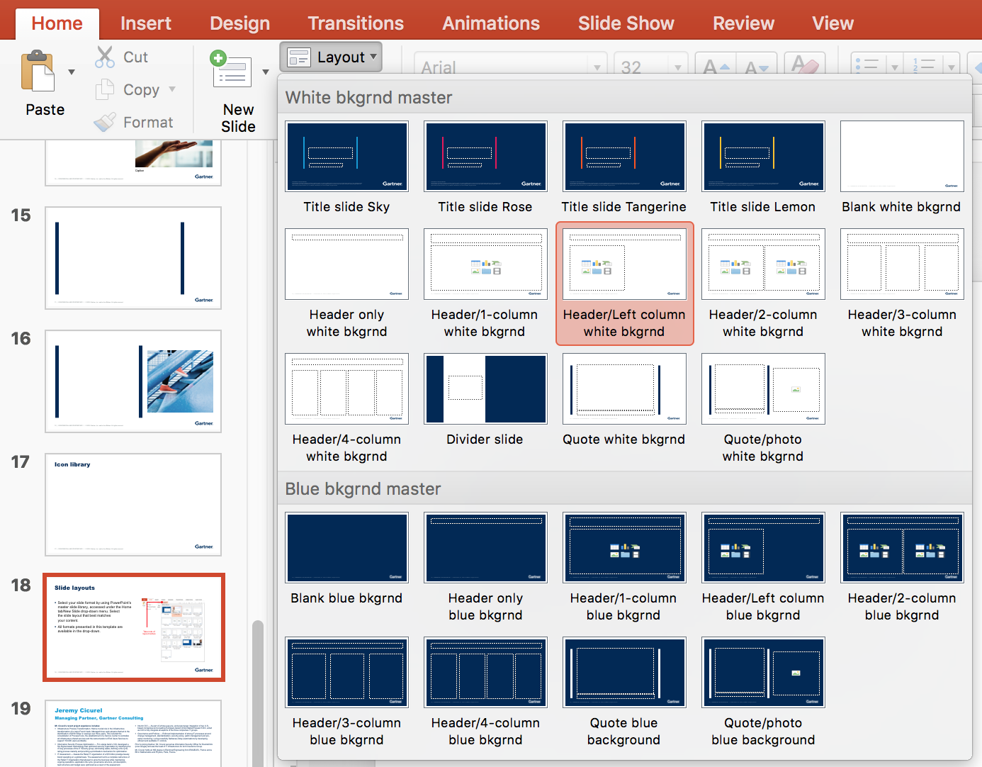
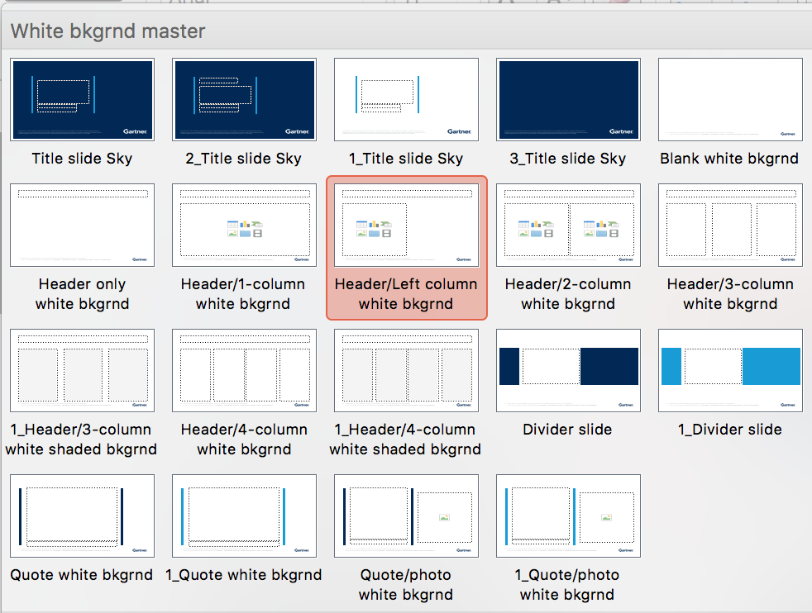

Time To Set Your Individual Goals Setting
Instructions: Activity 3: (15 min): HRBP to facilitate this activity requesting attendees to think of top 2 goals they need to develop ensuring they added KPI for each goals.
Individual SMART Goals | Success Measures
#Goal 1:
#Goal 2:
Before you develop your goals:
Ensure goals are aligned to divisional/functional goals.
Ensure all interdependencies have been identified .
Validate that measures selected are an indication of success in your goal.
Check that your individual goals are adding up to the team ambition

Slide 19




Peer Goal Sharing
Instruction : Activity 4: (20 min) Meeting owner to split the group into team of two and request that each employee share their goals with their peer to help employees achieve higher goal quality, feel more accountable for results and increase awareness of how individual outcomes fit with other priorities across the team and business.
Demonstrate how peers can challenge goals
Employee goal refinement
Collective teasing of goals
Collaboration mapping
Employee to share with peer their two goals & peer start using the questions in slide 21 to challenge the developed goals.
Employee refine goals based on peer feedback & switch roles & repeat activity
Employee starts mapping out who they need to collaborate with to achieve their individual goals
Team regroup. Volunteer start sharing individual goals with the entire team to collectively test with the HRBP & meeting owner and ensure successful output from activity. (preferable 4-5 volunteers)

Slide 20
Peer Goal Sharing
Instruction : Activity 4: HRBP to display the following questions so that peers can use in peer activity
Sample questions peers can use for providing feedback on individual goals
Are you working on the right goals to deliver your “piece of the puzzle” for our Division/Function goals?
Are these goals within your sphere of influence? If no, what are the interdependences?
Are your goals ambitious enough?
Have you identified what help you need from your team and peers to achieve your goals?
What are the risks to delivery of your goal? What steps will you take to mitigate the risk?

Slide 21
Conclusion and Next Steps for Employees
Reach out to your peers in your team or other teams to discuss collaboration plans (if you are dependent on them for achieving your goals) and resolve conflicts (if any).
Schedule 1:1 with your direct manager in order to algin on individual goals & discuss any challenges and support needed.
Complete your goals and put them on the IGrow by <dd/mm/yyyy>.
Reach out to your manager or HRBP <insert name and email of HRBP> for any support on the goal-setting process.

Slide 22
System Navigation

Slide 23
Al-Futtaim Balanced Score Card (BSC)
Instructions: Meeting owner to explain how BSC translated into Divisional/Functional goals & how Al-Futtaim use this to measure the performance of its employees and provides clarity and transparency to those employees and businesses in order for them to develop in their own roles and contribute to the progress of the organisation.
It is recommended that the number of goals should be between 3-6 for each individual and that no goal holds less than 10% weighting. The weight of each goal should be indicative of the amount of effort and work required to deliver on that goal. The sum total of the goals should add up to 100%.
04. FINANCIAL
01. MARKET
KPIs of how well Al-Futtaim is performing financially, including revenue, profitability and expenses.
Al-Futtaim’s performance in the context of the external or internal market; this includes customers, suppliers and principals
AL-FUTTAIM VALUES
LEADERSHIP COMPETENCIES
03. BUSINESS EXCELLENCE
02. PEOPLE
The internal processes Al-Futtaim uses to get the work done. making sure we optimise performance efficiency & effectiveness. Can also include major projects
Al-Futtaim performance on people metrics engagement, succession planning, Emiratisation.
BSC enables measurement of business performance across four quadrants:
Notes:
This is how the BSC is built if you have a goal falls under this.

Slide 24
MAKE A CONTRIBUTION. LEAVE A LEAGACY

Slide 25

Thank you for your time!
Any questions?

